Slide 1

HACKATHON 2017-18
Websocket based Notification
Mohini Memane
Jitesh Suthar

Slide 2
Project Details
Broadcasting currency rates to multiple users on real time basis using following technologies
Node.js
Redis
Websocket
Pubsub

Slide 3
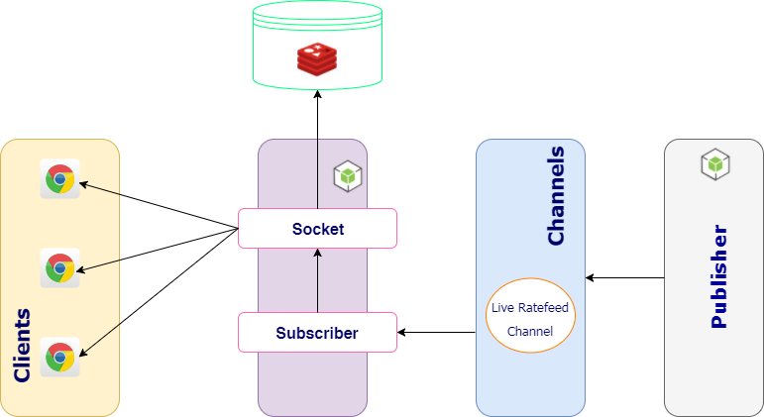
Architecture Diagram

Slide 4
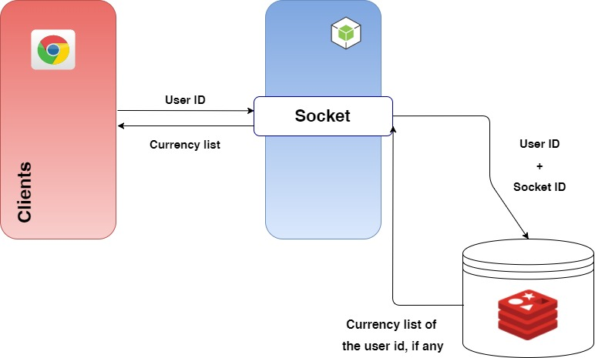
Socket Initialization

Slide 5
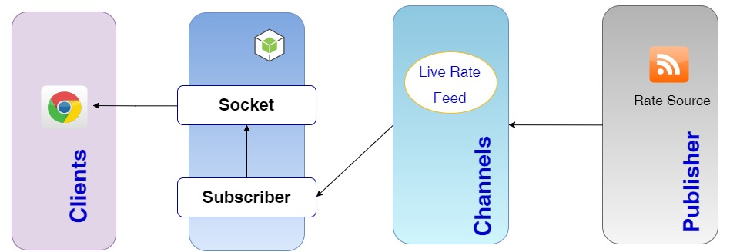
Pub-Sub Methodology

Slide 6
Lets Try
Currency subscription
Broadcasting rate
Notification one-to-one

Slide 7
Things Achieved
Message broadcasting.
Sending One-to-One message.
Flashing rate feed from Rate source based on user subscription.

Slide 8
Replicability
Flashing forex rates to users
One to one messaging
Broadcast message

Slide 9

What will we do next?
Build chat,notification & task manager server in node js

Slide 10
Thank You
Mohini Memane
Jitesh Suthar

